Slide 1
Linear Programming
A general approach for solving optimization problems in which the constraints and the optimization criterion are linear functions.
Step One: Express the problem as a linear program
Step Two: Solve the linear program using a standard algorithm such as the Simplex method.

Slide 2
Example Linear Program
Chocolate company has two products, Matin and Nuit. Here is the issue they face:
They can sell x boxes of Matin for a profit of $1 per box.
They can sell y boxes of Nuit for a profit of $6 per box.
They can sell at most 200 boxes of Matin and 300 of Nuit per day.
They can produce at most 400 total boxes per day.
What should they do to maximize profit?
We can express all this with a linear program:
Objective function:
Maximize x + 6y
Constraints:
x ≥ 0
y ≥ 0
x ≤ 200
y ≤ 300
x+y ≤ 400

Slide 3
Solving a Linear Program
Objective function:
Maximize x + 6y
Constraints:
x ≥ 0
y ≥ 0
x ≤ 200
y ≤ 300
x+y ≤ 400
Find a linear program solver and use it!
I used LPSolve, which is freely available. Let’s try it out using this program:
max: x + 6y;
x >= 0;
y >= 0;
x <= 200;
y <= 300;
x+y <= 400;

Slide 4
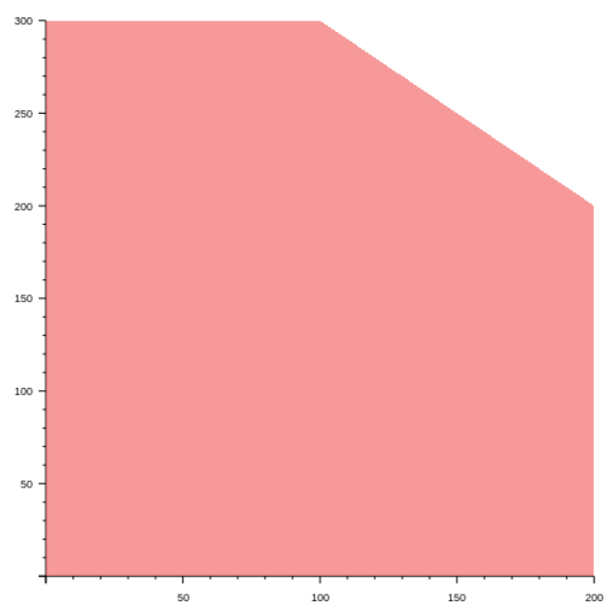
Solving a Linear Program
What’s going on behind the scenes? To understand, start by graphing the constraints:
Objective function:
Maximize x + 6y
Constraints:
x ≥ 0
y ≥ 0
x ≤ 200
y ≤ 300
x+y ≤ 400

Slide 5
Solving a Linear Program
The pink area is called the feasible region. One of the points in the feasible region will give us the (x, y) for which the objective function is maximized.
Objective function:
Maximize x + 6y
Constraints:
x ≥ 0
y ≥ 0
x ≤ 200
y ≤ 300
x+y ≤ 400

Slide 6
Solving a Linear Program
Now plot the objective function for a particular total:
x + 6y = 180 or y = 30 – x/6
Any point along the line inside the feasible region will give you an (x,y) that satisfies the constraints and such that the objective function evaluates to 180
Objective function:
Maximize x + 6y
Constraints:
x ≥ 0
y ≥ 0
x ≤ 200
y ≤ 300
x+y ≤ 400

Slide 7
Solving a Linear Program
As we make the value c of the objective function larger, the line moves upward.
x + 6y = c
How large can we make c while still intersecting the feasible region?
Objective function:
Maximize x + 6y
Constraints:
x ≥ 0
y ≥ 0
x ≤ 200
y ≤ 300
x+y ≤ 400

Slide 8
Solving a Linear Program
The objective function has its maximum value when it exits the feasible region at the vertex (100, 300) where its value is 1900. That’s the solution to the program.
Objective function:
Maximize x + 6y
Constraints:
x ≥ 0
y ≥ 0
x ≤ 200
y ≤ 300
x+y ≤ 400

Slide 9
Solving a Linear Program
The objective function will always have its maximum value at a vertex. To find the maximum value, we only need check at the vertices.
Objective function:
Maximize x + 6y
Constraints:
x ≥ 0
y ≥ 0
x ≤ 200
y ≤ 300
x+y ≤ 400

Slide 10
Solving a Linear Program
If a linear program has three variables, the feasible region is a polyhedron and the objective function is a plane. With even more variables, the idea is the same but it becomes tough to visualize!
Objective function:
Maximize x + 6y
Constraints:
x ≥ 0
y ≥ 0
x ≤ 200
y ≤ 300
x+y ≤ 400

Slide 11
Another Linear Program
Now three products: Matin, Nuit, Luxe.
They can sell x boxes of Matin for a profit of $1 per box.
They can sell y boxes of Nuit for a profit of $6 per box.
They can sell z boxes of Luxe for a profit of $13 per box.
They can sell at most 200 boxes of Matin and 300 of Nuit per day.
They can produce at most 400 total boxes per day.
The packaging machine used by Nuit and Luxe can run for 600 minutes per day. Nuit requires one minute/box; Luxe requires three minutes/box.
Objective function:
Maximize x + 6y + 13z
Constraints:
x ≥ 0
y ≥ 0
z ≥ 0
x ≤ 200
y ≤ 300
x+y+z ≤ 400
y+3z ≤ 600
max: x+6y+13z;
x >= 0;
y >= 0;
z >= 0;
x <= 200;
y <= 300;
x+y+z <= 400;
y+3z <= 600;

Slide 12
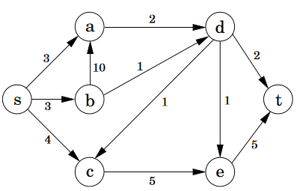
Linear Program for Network Flow
Oil is produced at vertex s and consumed at vertex t.
Edges are pipelines; weights are capacities of pipelines per hour.
Any oil that is piped in to a vertex (other than t) must be immediately piped out; oil can’t be stored.
What is the maximum amount of oil that can be piped per hour from vertex s to vertex t?

Slide 13
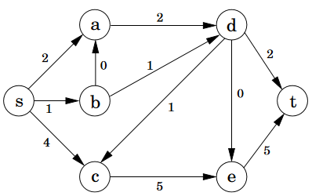
Preview of Solution

Slide 14
Linear Program for Network Flow
max: sa + sb + sc;
sa >= 0; sb >= 0; sc >= 0; ad >= 0; ba >= 0; bd >= 0; ce >= 0;
dc >= 0; de >= 0; dt >= 0; et >= 0;
sa <= 3; sb <= 3; sc <= 4; ad <= 2; ba <= 10; bd <= 1; ce <= 5;
dc <= 1; de <= 1; dt <= 2; et <= 5;
sa+ba = ad; sb = ba+bd; sc+dc = ce; ad+bd=dc+de+dt;
de+ce = et;

